Slide 1




TechTeam
Policy
Tech User
SalesTeam
RepairTeam

Slide 2
Arrows
3/5

Slide 3




























General Icons
4/5
AWS Marketplace
Client
Disk
Forums
Generic database
Internet
Internet alt1
Internet alt2
Mobile client
Firewall
Email
Multimedia
Office building
SAML token
SSL padlock
Tape storage
User
Users
Toolkit
SDK
Gear
Traditional server
Servers
Source code
Document
Documents
Folder
Folders
Globe
Shield
Generic application

Slide 4







General Icons
5/5
AWS Marketplace
Chat
Camera
Alert
Magnifying Glass
AWS Management Console
Git repository
Question

Slide 5

Analytics
STANDARD CATEGORY ICON

Slide 6

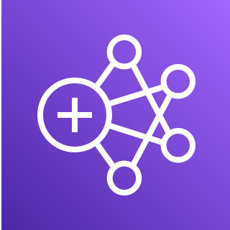





Analytics
1/5
Amazon CloudSearch
Amazon EMR
Amazon Kinesis
Search documents
Cluster
HDFS
cluster
EMR engine

Slide 7




Analytics
2/5
Amazon Kinesis Video Streams
Amazon Kinesis Data Streams
Amazon Kinesis Data Firehose
Amazon Kinesis Data Analytics

Slide 8






Analytics
3/5
AWS Glue
AWS Glue Elastic Views
Amazon Athena
Amazon OpenSearch Service
Crawler
AWS Glue Data Catalog

Slide 9







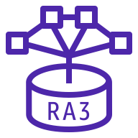

Analytics
4/5
Amazon Redshift
Amazon QuickSight
AWS Lake Formation
AWS Data Pipeline
Dense compute node
Dense storage node
Data lake
RA3
Redshift ML

Slide 10






Analytics
5/5
Amazon Managed Streaming for Apache Kafka
AWS Data Exchange
AWS Glue DataBrew
Amazon FinSpace
Amazon MSK Connect
AWS Data Exchange for APIs

Slide 11

Application Integration
STANDARD CATEGORY ICON

Slide 12



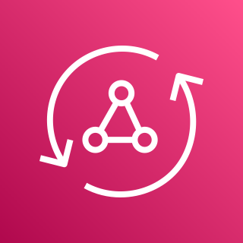






Application Integration
1/3
Amazon Simple Notification Service (Amazon SNS)
Amazon Simple Queue Service (Amazon SQS)
Amazon MQ
AWS AppSync
Email notification
Message
Broker
HTTP notification
Queue
Topic

Slide 13











Application Integration
2/3
AWS Step Functions
Amazon EventBridge
AWS Console Mobile Application
AWS Express Workflows
Event
Rule
Default
event bus
Custom
event bus
SaaS
event bus
Schema registry
Schema

Slide 14




Application Integration
3/3
Amazon AppFlow
Amazon Managed Workflows for Apache Airflow
Amazon API Gateway
Endpoint

Slide 15

Blockchain
STANDARD CATEGORY ICON

Slide 16



Blockchain
1/1
Amazon Managed Blockchain
Amazon Quantum Ledger Database (Amazon QLDB)
Blockchain

Slide 17

Business Applications
STANDARD CATEGORY ICON

Slide 18




Business Applications
1/3
Alexa for Business
Amazon Chime
Amazon WorkMail
Amazon Honeycode

Slide 19






Business Applications
2/3
Amazon Connect
Amazon Pinpoint
Amazon Simple Email Service (Amazon SES)
Amazon WorkDocs
Journey
Email

Slide 20

Business Applications
3/3
Amazon Chime SDK
Amazon Chime Voice Connector
Amazon Pinpoint APIs
Amazon WorkDocs SDK

Slide 21

Cloud Financial Management
STANDARD CATEGORY ICON

Slide 22




Cloud Financial Management
1/2
AWS Budgets
AWS Cost & Usage Report
AWS Cost Explorer
Reserved Instance (RI) Reporting

Slide 23




Containers
2/3
Amazon EKS Anywhere
Amazon EKS Cloud
Amazon EKS Distro
AWS Fargate

Slide 24



Customer Enablement
2/2
AWS Training and Certification
AWS Activate
AWS re:Post

Slide 25

Database
STANDARD CATEGORY ICON

Slide 26

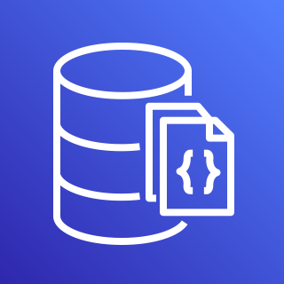







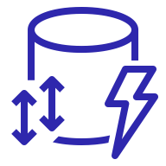


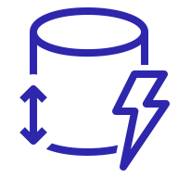
Database
1/5
Amazon Aurora
Amazon DocumentDB (with MongoDB compatibility)
Amazon DynamoDB
Attribute
Items
Amazon DynamoDB Accelerator (DAX)
Stream
Item
Table
Standard Access table class
Attributes
Global secondary
index
Standard–Infrequent Access table class

Slide 27





Database
2/5
Amazon Keyspaces (for Apache Cassandra)
AWS Database Migration Service (AWS DMS)
Amazon Neptune
Amazon Quantum Ledger Database (Amazon QLDB)
Database migration workflow or job

Slide 28









Database
3/5
Amazon Relational Database Service (Amazon RDS)
Amazon RDS on VMware
Amazon Timestream
Amazon ElastiCache
Multi-AZ
Cache node
ElastiCache
for Redis
Multi-AZ DB cluster
ElastiCache for Memcached

Slide 29

Database
4/5
Amazon MemoryDB for Redis

Slide 30











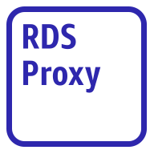
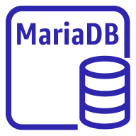
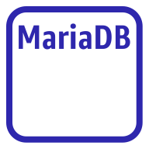


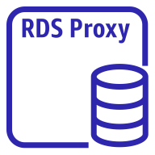
Database
5/5
Amazon Aurora instance
Amazon Aurora instance alternate
Amazon RDS instance
Amazon RDS
instance alternate
MySQL
instance
MySQL
instance alternate
Oracle
instance
Oracle
instance alternate
PostgreSQL instance
PostgreSQL
instance alternate
PIOPS instance
Amazon RDS
proxy instance alternate
MariaDB instance
MariaDB instance alternate
SQL Server
instance
SQL Server
instance alternate
Amazon RDS
proxy instance

Slide 31

Developer Tools
STANDARD CATEGORY ICON

Slide 32





Developer Tools
1/4
AWS Cloud9
AWS CodeBuild
AWS CodeCommit
AWS CodeDeploy
Cloud9

Slide 33




Developer Tools
2/4
AWS CodePipeline
AWS CodeStar
AWS Command Line Interface (AWS CLI)
AWS Tools and SDKs

Slide 34

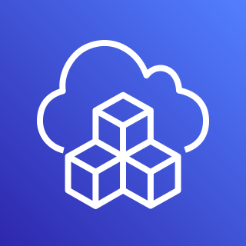


Developer Tools
3/4
AWS X-Ray
AWS Cloud Development Kit (AWS CDK)
AWS CodeArtifact
AWS CloudShell

Slide 35


Developer Tools
4/4
Amazon Corretto
AWS Cloud Control API

Slide 36

End User Computing
STANDARD CATEGORY ICON

Slide 37

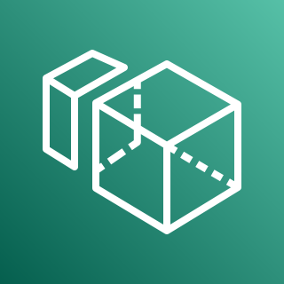


End User Computing
1/1
Amazon AppStream 2.0
Amazon WorkSpaces
Amazon WorkSpaces Web
Amazon WorkLink

Slide 38

Front-End Web & Mobile
STANDARD CATEGORY ICON

Slide 39









Front-End Web & Mobile
1/1
AWS Amplify
AWS Device Farm
Amazon Location Service
AWS Amplify Studio
Track
Place
Map
Geofence
Routes

Slide 40

Game Tech
STANDARD CATEGORY ICON

Slide 41




Game Tech
1/2
Amazon GameLift
AWS GameKit
Amazon GameSparks
Open 3D Engine

Slide 42

Game Tech
2/2
Amazon Lumberyard

Slide 43

Internet of Things
STANDARD CATEGORY ICON

Slide 44









Internet of Things
1/7
FreeRTOS
AWS IoT 1-Click
AWS IoT Analytics
AWS IoT Button
Channel
Dataset
Pipeline
Notebook
Data store

Slide 45






Internet of Things
2/7
AWS IoT Core
AWS IoT Device Defender
AWS IoT Device Management
AWS IoT Events
IoT device jobs
Fleet Hub

Slide 46






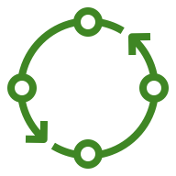












Internet of Things
3/7
AWS IoT Greengrass
AWS IoT SiteWise
AWS IoT Things Graph
Connector
Stream manager
Artifact
Component
Asset model
Asset
Component machine learning
Component nucleus
Component private
Component public
Properties
Data streams
Interprocess communication
Protocol
Recipe
Asset hierarchy

Slide 47




Internet of Things
4/7
AWS IoT ExpressLink
AWS IoT TwinMaker
AWS IoT RoboRunner
AWS IoT FleetWise

Slide 48

Internet of Things
5/7
AWS IoT EduKit

Slide 49



























Internet of Things
6/7
IoT action
IoT actuator
IoT certificate
IoT desired state
IoT hardware board
IoT HTTP protocol
IoT HTTP/2 protocol
IoT MQTT protocol
IoT policy
IoT reported state
IoT rule
IoT sensor
IoT servo
IoT shadow
IoT simulator
IoT topic
Alexa skill
Alexa Voice Service
Alexa-enabled device
Echo
Fire TV
Fire TV Stick
Lambda function
Over-the-air update
Device gateway
AWS IoT Core for LoRaWAN protocol
LoRaWAN protocol

Slide 50


























Internet of Things
7/7
IoT thing bank
IoT thing bicycle
IoT thing camera
IoT thing car
IoT thing cart
IoT thing coffee pot
IoT thing door lock
IoT thing factory
IoT thing generic
IoT thing house
IoT thing lightbulb
IoT thing travel
IoT thing medical emergency
IoT thing police emergency
IoT thing utility
IoT thing windfarm
IoT thing humidity sensor
IoT thing vibration sensor
IoT thing temperature sensor
IoT thing temperature & humidity sensor
IoT thing temperature & vibration sensor
IoT thing relay
IoT thing stack light
IoT thing FreeRTOS device
IoT thing industrial PC
IoT thing PLC

Slide 51

Machine Learning
STANDARD CATEGORY ICON

Slide 52




Machine Learning
1/9
Amazon Comprehend
Amazon Elastic Inference
Amazon Forecast
Amazon Lex

Slide 53










Machine Learning
2/9
Amazon Personalize
Amazon Polly
Amazon Rekognition
Amazon SageMaker
Amazon Rekognition image
Notebook
Canvas
Amazon Rekognition video
Model
Train

Slide 54




Machine Learning
3/9
Amazon SageMaker Ground Truth
Amazon Textract
Amazon Transcribe
Amazon Translate

Slide 55




Machine Learning
4/9
AWS Deep Learning AMIs
AWS Deep Learning Containers
AWS DeepLens
AWS DeepRacer

Slide 56



Machine Learning
5/9
Apache MXNet on AWS
TensorFlow on AWS
AWS DeepComposer
Amazon Augmented AI (Amazon A2I)

Slide 57




Machine Learning
6/9
Amazon Fraud Detector
Amazon Kendra
Amazon CodeGuru
TorchServe

Slide 58




Machine Learning
7/9
Amazon Lookout for Equipment
Amazon Lookout for Metrics
Amazon Lookout for Vision
Amazon Monitron

Slide 59





Machine Learning
8/9
Amazon DevOps Guru
Amazon HealthLake
AWS Panorama
AWS Neuron
Insights

Slide 60



Machine Learning
9/9
Amazon SageMaker Studio Lab
Amazon Comprehend Medical
Amazon CodeWhisperer

Slide 61

Management & Governance
STANDARD CATEGORY ICON

Slide 62















Management & Governance
1/8
Amazon CloudWatch
AWS Auto Scaling
AWS CloudFormation
Alarm
Rule
RUM
Change set
Stack
Event (time-based)
Event (event-based)
Evidently
Template
Logs
Synthetics
Metrics Insights

Slide 63






Management & Governance
2/8
AWS Application Auto Scaling
AWS Config
AWS License Manager
AWS Personal Health Dashboard
License blending
Application discovery

Slide 64











Management & Governance
3/8
AWS Management Console
AWS OpsWorks
AWS CloudTrail
Apps
Instances
Monitoring
Permissions
Deployments
Layers
Resources
Stack2

Slide 65















Management & Governance
4/8
AWS Service Catalog
AWS Systems Manager
Automation
Documents
Patch Manager
Parameter Store
OpsCenter
Inventory
Maintenance Windows
State Manager
Run Command
Session Manager
Change Manager
Change Calendar
Compliance

Slide 66








Management & Governance
5/8
AWS Trusted Advisor
AWS Well-Architected Tool
AWS Control Tower
Checklist
cost
Checklist
performance
Checklist
security
Checklist
fault tolerant
Checklist

Slide 67
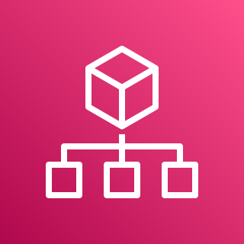






Management & Governance
6/8
AWS Organizations
AWS AppConfig
AWS Chatbot
AWS Backint Agent
Account
Organizational unit
Management account

Slide 68




Management & Governance
7/8
AWS Fault Injection Simulator
Amazon Managed Grafana
Amazon Managed Service for Prometheus
AWS Distro for OpenTelemetry

Slide 69




Management & Governance
8/8
AWS Proton
AWS Launch Wizard
AWS Systems Manager Incident Manager
AWS Resilience Hub

Slide 70

Media Services
STANDARD CATEGORY ICON

Slide 71





Media Services
1/4
Amazon Elastic Transcoder
Amazon Kinesis Video Streams
AWS Elemental MediaConnect
AWS Elemental MediaConvert
AWS Cloud Digital Interface

Slide 72




Media Services
2/4
AWS Elemental MediaLive
AWS Elemental MediaPackage
AWS Elemental MediaStore
AWS Elemental MediaTailor

Slide 73

Media Services
3/4
AWS Elemental Conductor
AWS Elemental Delta
AWS Elemental Live
AWS Elemental Server

Slide 74



Media Services
4/4
AWS Elemental Appliances & Software
Amazon Interactive Video Service
AWS Elemental Link
Amazon Nimble Studio

Slide 75

Migration & Transfer
STANDARD CATEGORY ICON

Slide 76











Migration & Transfer
1/2
AWS Application Discovery Service
AWS Transfer Family
AWS DataSync
AWS Migration Hub
AWS FTPS
Agent
Refactor Spaces services
AWS SFTP
Refactor Spaces applications
AWS FTP
Refactor Spaces environments

Slide 77









Migration & Transfer
2/2
AWS Server Migration Service (AWS SMS)
AWS Application Migration Service
AWS Migration Evaluator
AWS Mainframe Modernization
Analyzer
Compiler
Converter
Runtime
Developer

Slide 78

Networking & Content Delivery
STANDARD CATEGORY ICON

Slide 79







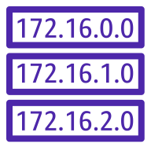








Networking & Content Delivery
1/5
AWS Transit Gateway
Amazon CloudFront
Amazon Route 53
Attachment
Download distribution
Edge location
Hosted zone
Route table
Readiness checks
Streaming distribution
Functions
Resolver
Resolver DNS firewall
Routing controls
Resolver query logging
Application recovery controller

Slide 80

















Networking & Content Delivery
2/5
Amazon Virtual Private Cloud (Amazon VPC)
Customer gateway
Internet gateway
VPN gateway
Flow logs
Endpoints
Router
Traffic mirroring
NAT gateway
Elastic network interface
Elastic network adapter
Network access control list
VPN connection
Peering connection
Reachability analyzer
Carrier gateway
Network access analyzer

Slide 81













Networking & Content Delivery
3/5
AWS App Mesh
AWS Cloud Map
AWS Direct Connect
AWS Global Accelerator
Mesh
Virtual
gateway
Service
Gateway
Virtual node
Virtual router
Namespace
Virtual service
Resource

Slide 82








Networking & Content Delivery
4/5
AWS Client VPN
AWS Site-to-Site VPN
Elastic Load Balancing
AWS PrivateLink
Application Load Balancer
Network Load Balancer
Classic Load Balancer
Gateway Load Balancer

Slide 83




Networking & Content Delivery
5/5
AWS Cloud WAN
AWS Private 5G
Segment network
Core network edge

Slide 84

Quantum Technologies
STANDARD CATEGORY ICON

Slide 85










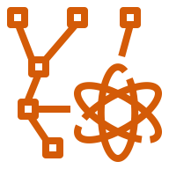



Quantum Technologies
1/1
Amazon Braket
Chandelier
Chip
QPU
Simulator
Simulator 1
Simulator 2
Simulator 3
Simulator 4
State vector
Tensor network
Noise simulator
Embedded simulator
Managed simulator

Slide 86

Robotics
STANDARD CATEGORY ICON

Slide 87





Robotics
1/1
AWS RoboMaker
Cloud extensions ROS
Development environment
Fleet
management
Simulation

Slide 88

Satellite
STANDARD CATEGORY ICON

Slide 89

Satellite
1/1
AWS Ground Station

Slide 90

Security, Identity, & Compliance
STANDARD CATEGORY ICON

Slide 91





Security, Identity, & Compliance
1/6
Amazon Cloud Directory
Amazon Cognito
Amazon GuardDuty
Amazon Inspector
Agent

Slide 92

















Security, Identity, & Compliance
3/6
AWS Directory Service
AWS Firewall Manager
AWS Identity and Access Management (IAM)
Simple AD
Add-on
Permissions
MFA token
Role
AD Connector
AWS STS
AWS STS alternate
Long-term security
credential
IAM Access Analyzer
AWS Managed Microsoft AD
Encrypted data
Data encryption key
Temporary security credential
IAM Roles Anywhere

Slide 93






Security, Identity, & Compliance
4/6
AWS Key Management Service (AWS KMS)
AWS Secrets Manager
AWS Security Hub
AWS Shield
Finding
AWS Shield Advanced

Slide 94











Security, Identity, & Compliance
5/6
AWS IAM Identity Center (successor to AWS Single Sign-On)
AWS WAF
Amazon Detective
AWS Resource
Access Manager
Rule
Managed rule
Filtering rule
Labels
Bot
Bad bot
Bot control

Slide 95




Security, Identity, & Compliance
6/6
AWS Audit Manager
AWS Network Firewall
AWS Signer
Endpoints

Slide 96

Serverless
STANDARD CATEGORY ICON

Slide 97



Serverless
1/1
Serverless is a way to describe the services that enable you to build and run applications without thinking about servers. AWS has serverless services for all layers of your stack. In many public forums, like our marketing website, we list these services under the Serverless heading because it improves discoverability.
When it comes to building an architecture diagram, it’s more intuitive to use a functional categorization. Please find the architecture icon for each serverless service in its functional category. You can use the serverless category icon to describe serverless applications or architectures.
Compute
Containers
Application Integration
Storage
Database
AWS Lambda
AWS Fargate
Amazon SQS
Amazon SNS
Amazon EventBridge
AWS Step Functions
AWS AppSync
Amazon S3
Amazon DynamoDB
Amazon Aurora Serverless

Slide 98
Storage
STANDARD CATEGORY ICON

Slide 99













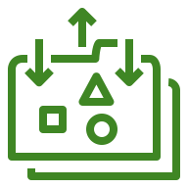








Storage
1/6
Amazon Elastic Block Store (Amazon EBS)
Amazon Elastic File System (Amazon EFS)
AWS Storage Gateway
Snapshot
Multiple volumes
File system
One Zone
Noncached
volume
Cached
volume
Amazon FSx
File Gateway
Volume
Volume gp3
One Zone Infrequent Access
Standard
Virtual tape
library
Tape
Gateway
Amazon S3
File Gateway
Amazon Data Lifecycle Manager
Standard–Infrequent Access
Intelligent-Tiering
Volume
Gateway
File
gateway

Slide 100





Storage
2/6
Amazon FSx for Lustre
Amazon FSx for Windows File Server
Amazon FSx
CloudEndure Disaster Recovery
File system
File system

Slide 101

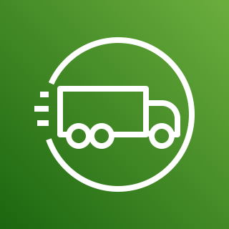



Storage
3/6
AWS Snowball Edge
AWS Snowmobile
AWS Snowball
AWS Snowcone
Snowball import-export

Slide 102


















Storage
4/6
Amazon Simple Storage Service (Amazon S3)
S3 Standard
S3 Intelligent- Tiering
S3 Standard-IA
S3 One Zone-IA
S3 Glacier Flexible Retrieval
S3 Glacier Deep Archive
S3 Glacier Instant Retrieval
S3 on Outposts
Bucket
Bucket with
objects
Replication
S3 Replication Time Control
S3 Storage Lens
Access points
VPC access points
Object
S3 Object Lambda
S3 Object Lambda access points

Slide 103






Storage
5/6
Amazon S3 on Outposts
Amazon Simple Storage Service Glacier
Amazon FSx for NetApp ONTAP
Amazon FSx for OpenZFS
Vault
Archive

Slide 104
















Storage
6/6
AWS Backup
Backup plan
Backup vault
Virtual machine
Virtual machine monitor
AWS Backup support for VMware workloads
Recovery point objective
Recovery time objective
Database
Storage
AWS Backup support for Amazon S3
Compliance reporting
Backup restore
Gateway
Compute
AWS Backup support for Amazon FSx for NetApp ONTAP

Slide 105

VR & AR
STANDARD CATEGORY ICON

Slide 106
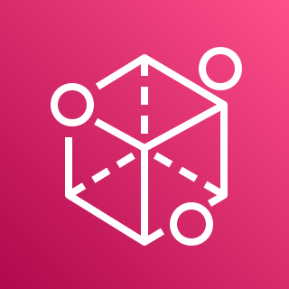
VR & AR
1/1
Amazon Sumerian

Slide 107





Security, Identity, & Compliance
2/6
Amazon Macie
AWS Artifact
AWS Certificate Manager (ACM)
AWS CloudHSM
Certificate authority

